Slide 1

Alta Ultrasonic Sensors

Slide 2
Introduction
ALTA Ultrasonic Sensors can be used in a variety of applications for measuring distances between the sensor and objects in its path.
ALTA ultrasonic sensors are imperviousness to target surface and colour, and feature autocalibration algorithms which allow them to adapt to variable environmental conditions and compensate for temperature and humidity effects.
The ultrasonic sensors can also be calibrated through the iMonnit software for greater accuracy in distance measurements.
Measures distance between the sensor and objects in its path
Measurement resolution of 1 centimetre
Auto-calibration algorithms allow sensor to adapt to variable environmental conditions

Slide 3
Principle of Operation
The Ultrasonic Sensor sends out a high-frequency sound pulse and then times how long it takes for the echo of the sound to reflect back.
The sensor has 2 openings on its front. One opening transmits ultrasonic waves, (like a tiny speaker), the other receives them, (like a tiny microphone).
The ultrasonic sensor uses the speed of sound to and time difference between sending and receiving the sound pulse to determine the distance to an object.
It will take readings at set intervals and report the data back to the iMonnit software portal where the information is processed to display distance and alert users if a defined condition is met.
All sensor data is then stored for historical analysis

Slide 4
Example Interfacing
Liquid Level Detection
Object/Vehicle Detection
Inventory Status (based on distance measurement)

Slide 5
Features
Wireless range of 1,200+ feet through 12+ walls
Frequency-Hopping Spread Spectrum (FHSS)
Improved interference immunity
Improved power management for longer battery life
Encrypt-RF® Security - All ALTA sensors now have up to 3200 readings:
- 10-minute heartbeats = 22 days
- 2-hour heartbeats = 266 days
Over-the-air updates (future proof)
Free iMonnit basic online wireless sensor monitoring and notification system to configure sensors, view data and set alerts via SMS text and email

Slide 6
Setup and Installation
Step 1:
Add the sensor on iMonnit. Add the sensor to your account by choosing Sensors in the main menu. Navigate to the Add Sensor button.
. Find the device ID. The Device ID (ID) and Security Code (SC) are necessary to add a sensor. These can both be located on the label on the side of your device.
Adding your device. You will need to enter the Device ID and the Security Code from your Sensor in the corresponding text boxes. Use the camera on your smartphone to scan the QR code on your device.
If you do not have a camera on your phone, or the system is not accepting the QR code, you may enter the Device ID and Security Code manually.
The Device ID is a unique number located on each device label. Next, you’ll be asked to enter the Security Code from your device. A security code consists of letters and must be entered in upper case (no numbers). It can also be found on the barcode label of your device.
When completed, select the Add Device button.

Slide 7
Setup and Installation
Step 2: Setup
Select your use case. Choose from the list or create your own custom settings. You will see the heartbeat interval, and aware state settings. Select the Skip button when completed.
Step 3: Validation
Check your signal. The validation checklist will help you ensure your sensor is communicating with the gateway properly and you have a strong signal.
Step 4: Actions
Choose your actions. Actions are the alerts that will be sent to your phone or email in the event of an emergency.
Industrial sensors come shipped with a 3.6V Lithium battery already installed. They do not need to be taken apart for battery installation and are not rechargeable.
The standard version of this sensor is powered by two replaceable 1.5 V AA sized batteries (included with purchase). The typical battery life is up to 10 years.

Slide 8
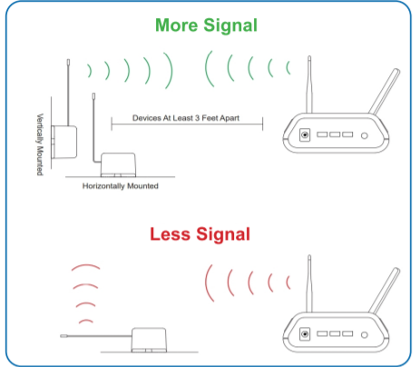
Antenna orientation
In order to get the best performance out of your ALTA Wireless Sensors, it is important to note proper antenna orientation and sensor positioning. Antennas should all be oriented in the same direction, pointing vertically from the sensor.
If the sensor is mounted flat on its back on a horizontal surface, you should bend the antenna as close to the sensor housing as possible giving you the most amount of antenna pointing vertical.
You should make the antenna wire as straight as possible, avoiding any kinks and curving of the wire. Sensors must be at least 3 ft. away from other sensors and the wireless gateway to function.

Slide 9

Sensor Overview In iMONNIT
Select Sensors from the main navigation menu on iMonnit to access the sensor overview page and begin making adjustments to your Advanced Vibration Meter.
A. Details - Displays a graph of recent sensor data.
B. History - List of all past heartbeats and readings.
C. Events - List of all events attached to this sensor.
D. Settings - Editable levels for your sensor.
E. Scale - Set the scale your sensor will take readings at
Directly under the tab bar is an overview of your sensor. This allows you to see the signal strength and the battery level of the selected sensor. A coloured dot in the left corner of the sensor icon denotes its status.
Green indicates the sensor is checking in and within user-defined safe parameters.
Red indicates the sensor has met or exceeded a user-defined threshold or triggered event.
Grey indicates that no sensor readings are being recorded, rendering the sensor inactive.
Yellow indicates that the sensor reading is out of date, due to perhaps a missed heartbeat check-in.

